Slide 1
Parallel Programming

Slide 2
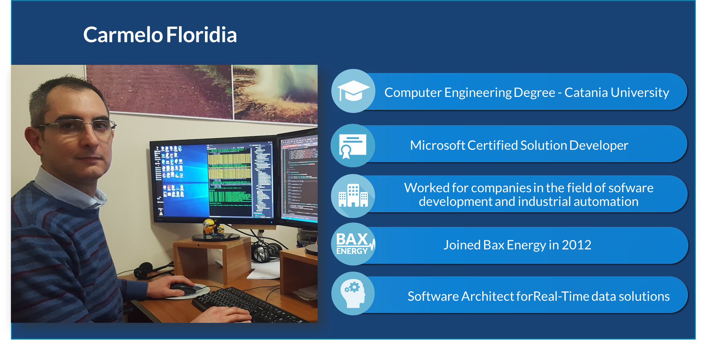
About me

Slide 3
Introduction
Parallel programming: the ability for an application to do more than one task simultaneously.
With the widespread use of multiprocessor and multicore computers, parallel programming has gone mainstream.
Improving of parallel programming features starting from .NET 4
The new .NET parallel programming features are built on top of the classic threading support: Task Parallel Library
The basic unit of the TPL is the task
Reduce the amount of code you have to write to create a parallel application

Slide 4
Benefits of parallel programming
The work of a program is broken up into pieces, which are performed by multiple cores, processors, or computers.
Deciding when to go parallel
Considering Overhead: concurrency is not for free.
Some problems are inherently sequential in nature.
Handle activities flow through pipeline.
Notes:
Parallel computing is, at heart, a performance play. The work that a program performs is broken up into
pieces, which are performed by multiple cores, processors, or computers. Some of those pieces of work
will be performed at the same time, that is, in parallel, or concurrently, which is where the two key terms
for this kind of programming arise. Writing the code that breaks up and arranges for parallel computing
is called parallel programming.
Considering Overhead
Parallel execution doesn’t come for free. There are overhead costs associated with setting up and
managing parallel programming features. If you have only a small amount of work to perform, the
overhead can outweigh the performance benefit.
Coordinating Data
If your pieces of work share common data or need to work in a concerted manner, you will need to
provide coordination. I explain this is detail in Chapters 3 and 4, but as a general rule, the more
coordination that is required, the poorer the performance of your parallel program. If the pieces of work
can be performed in complete isolation from one another, you don’t have to worry. But such situations
are uncommon, and mostly, you will have to take care to ensure that coordination is used to get the
results you desire.
Applying coordination is not hard, but applying just the right amount is a trick that comes with
forethought and experience. Too much coordination compromises the performance of your parallel
program; too little gets you unexpected results.
Deciding When to Go Parallel
The key is measurement. Don’t just assume that a parallel solution will give you better performance
and move on
Some problems are
inherently sequential in nature—there are no pieces of work that can be performed concurrently.

Slide 5
Task Parallel Library
Task Creation
To create the simplest of Tasks, you only need to have a task body, that is, a delegate or action that represents the workload you want performed in parallel.
TaskCreationOptions
Task Start
The method start() allow the task to run and perform its workload
Task Completion
A completed task cannot be restarted. A new instance must be created and started

Slide 6
Task Parallel Library
Setting Task State
Allows Tasks to perform similar workloads on different data
The only way to pass state to a Task constructor is using Action<object>
Explicit cast is needed if you need to access the members of a specific type
Getting Task Result
create instances of Task<T>, where T is the type of the result that will be produced and return an instance of that type in your Task body
Get the "Result" property to read the result

Slide 7
Task Cancellation
Create a new instance of System.Threading.CancellationTokenSource
CancellationTokenSource tokenSource = new CancellationTokenSource();
Call the CancellationTokenSource.Token property to get a System.Threading.CancellationToken:
CancellationToken token = tokenSource.Token;
Create a new Task or Task<T> using an Action or Action<object> delegate and the CancellationToken from step 2 as constructor arguments:
Task task1 = new Task(new Action(myMethod), token);
Call the Start() method on your Task or Task<T> as you would normally.
To cancel a Task, simply call the Cancel() method on the CancellationTokenSource created in step 1
Task cancellation is cooperative, which means that the .NET Framework doesn’t force your tasks to finish; you have to monitor the CancellationToken you used to create your task and stop your task when you detect that a cancellation has been requested

Slide 8
Waiting for Task completion
Single Task
Wait()
Wait(CancellationToken)
Wait(Int32)
Wait(TimeSpan)
Wait(Int32,CancellationToken)
Multiple Tasks
Task.WaitAll(params Task[] tasks)
Task.WaitAny(params Task[] tasks)

Slide 9
Handling Task Exception
UnhandledException causes the process exit
AggregateException

Slide 10
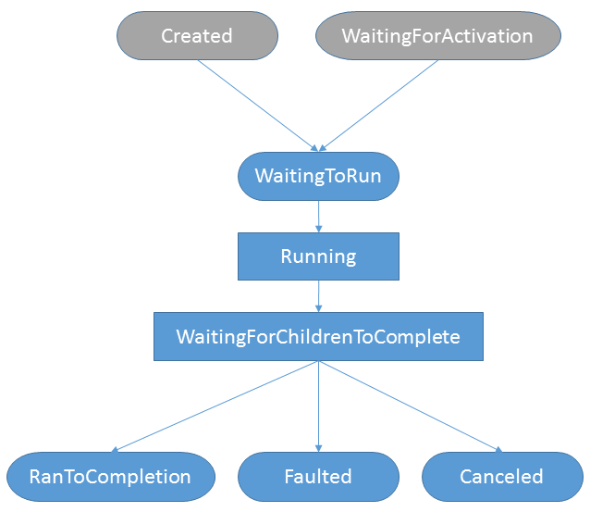
Task Life Cycle
Created: The task has been initialized but not yet scheduled.
WaitingForActivation WaitingToRun:
The task is waiting to be scheduled or has been scheduled and is awaiting execution.
Running: The task is running.
WaitingForChildrenToComplete: The task is waiting for a child to complete.
RanToCompletion: The task completed without being cancelled and without anexception being thrown.
Canceled: The task was cancelled
Faulted: The task threw an exception

Slide 11
Concurrency Control
Basic Synchronization Primitives
ensure that only one Task is able to enter a critical region
lock (lockObj) {
...critical section code...
}
… is equivalent to:
bool lockAcquired;
try {
Monitor.Enter(lockObj, ref lockAcquired);
...critical region code...
} finally {
if (lockAcquired) Monitor.Exit(lockObj);
}

Slide 12
Concurrency Control
Interlocked Operations
Exchange(ref Int32, Int32)
Add(ref Int32, Int32)
Increment(ref Int32)
Decrement(ref Int32)
CompareExchange(ref Int32, Int32, Int32)

Slide 13
Concurrency Control
Reader-Writer Lock
ReaderWriterLockSlim is a common performance optimization and contains two locks—one for reading data and one for writing data—and allows multiple reader Tasks to acquire the read lock simultaneously. When a writer comes along and requests the write lock, it is made to wait for any active readers to release the read lock before being allowed to proceed
EnterReadLock(), ExitReadLock()
EnterWiteLock(), ExitWriteLock()
EnterUpgradeableReadLock(), ExitUpgradeableReadLock() for nested locks

Slide 14
Concurrent Collections
ConcurrentQueue: First-In / First-Out
ConcurrentStack: Last-In / First-Out
ConcurrentBag: not order
ConcurrentDictionary: key value object

Slide 15
Task Coordination
Coordinate activity between and amongst groups of Tasks using synchronization primitives
ManualResetEventSlim: signalling events
AutoResetEvent: signalling events
SemaphoreSlim: restrict the degree of concurrency
Barrier: multiphase parallel algorithm
Supervisor and Workers
Are group of tasks
Supervisors give directives to workers
They communicate using "go" and "wait" messages
Notes:
The System.Threading.SemaphoreSlim class allows you to specify how many waiting worker Tasks are
released when the event is set, which is useful when you want to restrict the degree of concurrency
among a group of Tasks. The supervisor releases workers by calling the Release() method. The default
version releases one Task, and you can specify how many Tasks are released by providing an integer
argument. The constructor requires that you specify how many calls to the Wait() method can be made
before the event is reset for the first time. Specifying 0 resets the event immediately, and any other value
sets the event initially and then allows the specified number of calls to the Wait() method to be made
without blocking before the event is reset.

Slide 16
Parallel Producer/Consumer Pattern
Allows us to decouple the production from the consumption of items
The flow of work from the producers to the consumers is mediated by a collection, typically a queue
A synchronization primitive is used so that the producers can signal the consumers when work items are available to be processed
System.Collections.Concurrent.BlockingCollection combines the collection and the synchronization primitive into one class

Slide 17
Asynchronous Patterns
For I/O or CPU bound needs asynchronous programming is required
C# has a language-level asynchronous programming model
It follows the Task-based Asynchronous Pattern (TAP) and is supported by the async / await keywords

Slide 18
Data Parallelism: Parallel Loops
Parallel.For
for (int number = start; number < end; ++number)
{
if (IsPrime(number))
{
primes.Add(number);
}
}
Parallel.For(start, end, number =>
{
if (IsPrime(number))
{
lock(primes)
{
primes.Add(number);
}
}
});
Going parallel is not always the best solution. It depends …
Notes:
Offer higher-level abstraction over the task. The source of parallelism is not the algorithm’s code, but rather the data on which it operates.
Data partitioning.
Parallel.For adapts slowly to the execution
pace of individual iterations, takes into account the number of tasks currently executing, and prevents toogranular
behavior by dividing the iteration range dynamically.

Slide 19
Bibliography
Pro .NET 4 Parallel Programming in C# - Apress
https://docs.microsoft.com/en-us/dotnet/csharp/async

